Slide 1
Language Identification
SHUBHAM PATIL
ECKOVATION
PYTHON PROGRAMMING

Slide 2
INTRODUCTION

Slide 3
Intro
Language identification or language guessing is the problem of determining which natural language given content is in.
In this project, we have used Textblob Library for processing textual data.
It provides a simple API for diving into common natural language processing (NLP) tasks such as part-of-speech tagging, noun phrase extraction, sentiment analysis, classification, translation, and more.

Slide 4
Features of Textblob
• Noun phrase extraction • Part-of-speech tagging • Sentiment analysis • Classification (Naive Bayes, Decision Tree) • Language translation and detection powered by Google Translate • Tokenization (splitting text into words and sentences) • Word and phrase frequencies • Parsing • n-grams • Word infection (pluralization and singularization) and lemmatization • Spelling correction • Add new models or languages through extensions

Slide 5
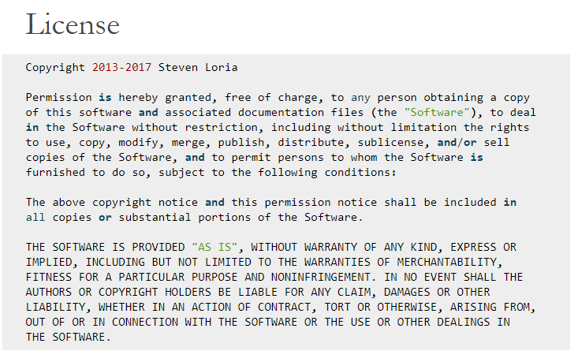
License
TextBlob stands on the giant shoulders of NLTK and pattern.
The data sets are in JSON format, to be able to read in pandas dataframe.
Next slide will give you brief information of how textblob works.

Slide 6
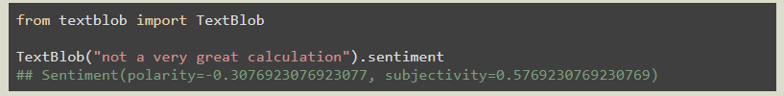
How does Textblob calculate sentiment?
Based on the polarity and subjectivity, you determine whether it is a positive text or negative or neutral. For TextBlob, if the polarity is >0, it is considered positive, <0 - is considered negative and ==0 is considered neutral.
This tells us that the English phrase “not a very great calculation” has a polarity of about -0.3, meaning it is slightly negative, and a subjectivity of about 0.6, meaning it is fairly subjective.

Slide 7
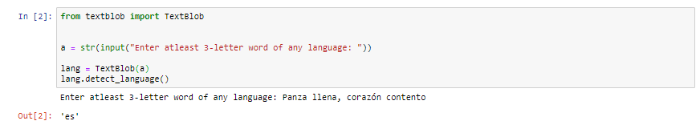
Above, “Panza llena, corazón contento” is a Spanish sentence.
Hence, Textblob gives an output as “es” which determines Espanol(Spanish).

Slide 8

Conclusion
We showed that this project accurately estimate the proportion of the document written in each of the languages identified.

Slide 9
We showed that the system out performs alternative approaches from the literature on synthetic data as well as on real-world data from research on languages using the web as a resource.

Slide 10

Thank You!
SHUBHAM PATIL
ECKOVATION
PYTHON PROGRAMMING

